Slide 1




Climate Change and Cocoa Production
Devon Schools’ Fairtrade Conference
2025

Slide 2
What do we know about Climate Change?
Causes and Impacts?

Slide 3
The impact of climate change on the quality and quantity of cocoa pods in Ghana
Unpredictable weather – disrupts farmer’s plans
Temperature change– extreme high temperature adversely affects cocoa production
Change in rainfall – less rainfall will reduce cocoa output as now there is a longer dry season
Extreme weather - torrential rain causes flooding, lightening, storms and landslides ruins all crops.

Slide 4
Because of climate change weather in Ghana has become very unpredictable for the whole population.
Through Kuapa Kokoo cocoa farmers are trying to adapt to and mitigate the impact.

Slide 5
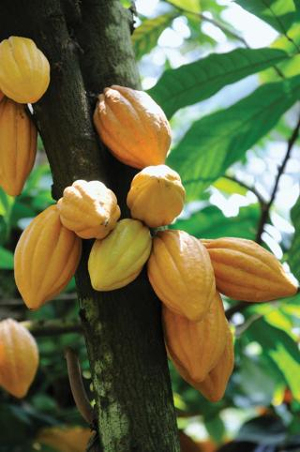
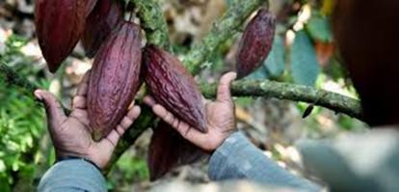
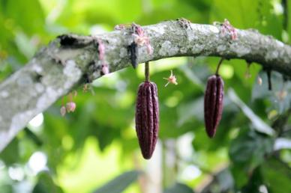
Higher Temperatures
Impact – reduces the quality and quantity of cocoa pods

Slide 6
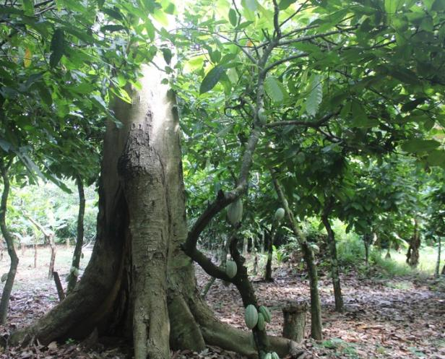
Mitigation
Shade trees are used to combat temperature increases and to
protect cocoa plantations forming a micro- climate.
Some farmers have always done this.

Slide 7

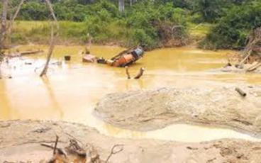
Change in Rainfall
This has led to cocoa researchers developing more resilient cocoa trees. Farmers are now using a hybrid cocoa tree.
Drought
Flooding

Slide 8
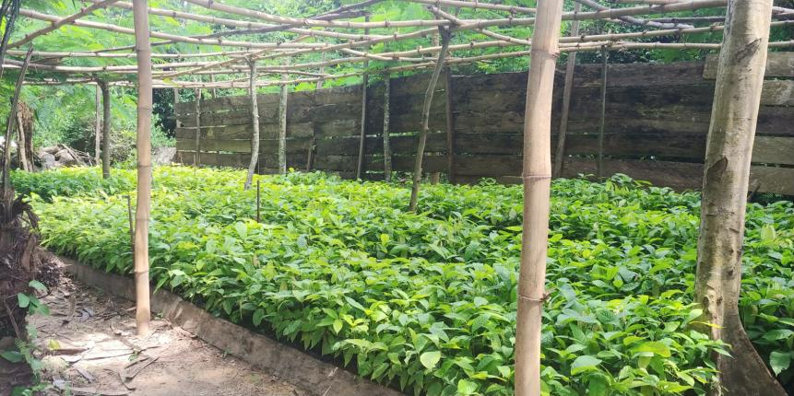
Hybrid cocoa trees growing in a nursery

Slide 9


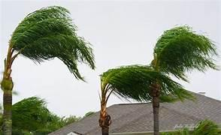
Extreme weather

Slide 10
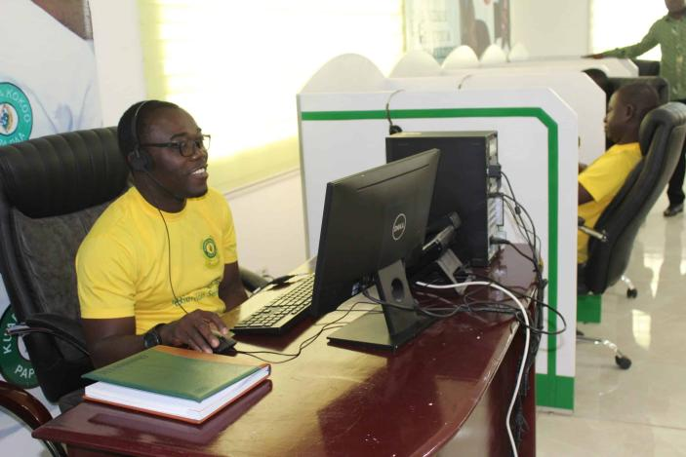
Use of technology
radio, smart phones and computers
to give updates on
weather reports and advice to help cocoa farmers
prepare and plan.

Slide 11
Some practical actions for cocoa farmers to live
with climate change in Ghana
Plant more trees for shade on the cocoa farms. This will help shield them from the rise in temperature.
Research - hybrid cocoa trees are being developed to withstand higher temperatures and a variation in rainfall.
Weather forecast - use of technology e.g. to warn of incoming storms.
Diversification – includes planting food crops, making soap, handicrafts etc as income from cocoa production reduces.

Slide 12


Slide 13
What do we know about Climate Change?
Causes and Impacts?

Slide 14

So, what can we do in school?

Slide 15

Let’s Go Zero is the national campaign uniting teachers, pupils, parents and their schools as they all work together to be zero carbon by 2030.
That’s a huge challenge –
but transforming schools will help
safeguard the planet for future generations.
.

Slide 16
Many UK schools are working to become zero carbon by 2030, but they will all need more government support to hit this goal. The Let’s Go Zero campaign is calling for seven government actions – achievable, affordable steps in-line with the country’s zero carbon ambitions.

Slide 17
Seven steps to create zero carbon schools:
1. The government commits to all UK schools being zero carbon by 2030 Not committed
2.Government ensures investment in training teachers in education for sustainable development across the curriculum and give all learners a connection to nature. Achieved- in strategy
3. The government commits to investing in adapting and retrofitting the school estate. Not committed
4. The Department for Education commits to improving their building specifications, so that all new school buildings from 2022 onwards will be net zero carbon. Achieved- annouced in November 2021
5. By 2025, every school is mandated to have a funded Climate Action Plan to result in zero carbon status. Achieved- in strategy
6. Every school should have a trained staff member who acts as a Sustainability Lead. Achieved- in strategy
7. Sustainability to be embedded as a statutory feature of careers guidance in UK schools by 2025. Not committed

Slide 18

Let’s Go Zero calls for government action on zero carbon schools

Slide 19
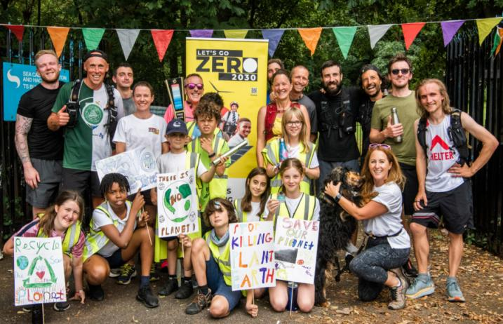
Join schools, colleges, and nurseries across the UK on their journey to zero carbon
Email: letsgozero@ashden.org

Slide 20
Create your own bookmark
On this side - write reasons for
buying Fairtrade Chocolate
On the other side –
Let’s Go Zero! Climate
Action!

Slide 21
Buying Fairtrade Chocolate
No Child Labour - Fairer Pay for Farmers
Guaranteed price – Fairtrade Premium
Care for the Environment – Safe Working Conditions
Dark Chocolate- Healthy Option
Higher amount of cocoa – Tastes great
Let’s Go Zero – reduce our carbon footprint
Better for health
Environmental Protection
Healthier Food
Energy Security
Reduce Climate Change
Nature Protection
Economic Growth
Job Creation

