Slide 1

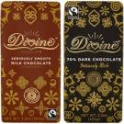



Welcome to Devon Schools’
Fairtrade Conference
2025

Slide 2

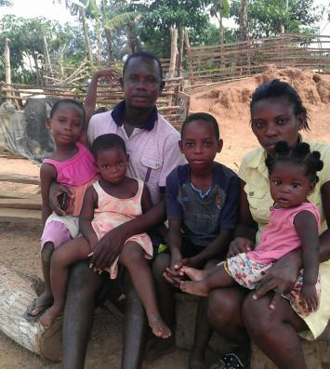



The Kuapa Kokoo Story
How Divine Chocolate
began in Ghana?
Here is a KK Cocoa farmer
Isaac Baidoo with his family

Slide 3
Kuapa Kokoo Farmer’s Union
A Fairtrade Cocoa Farmer’s Union was
established in Ghana, West Africa
in 1993 by 2,000 farmers. It has worked
since then to improve the total well – being
of all its members now over 100,000.

Slide 4
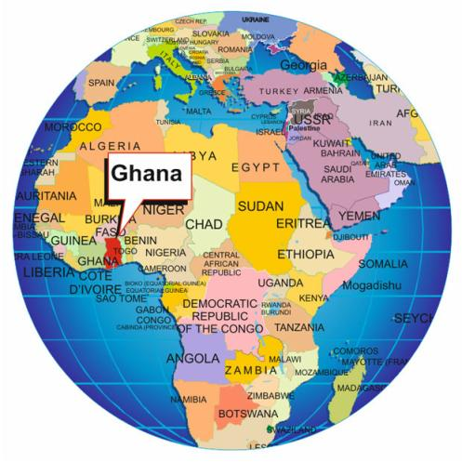
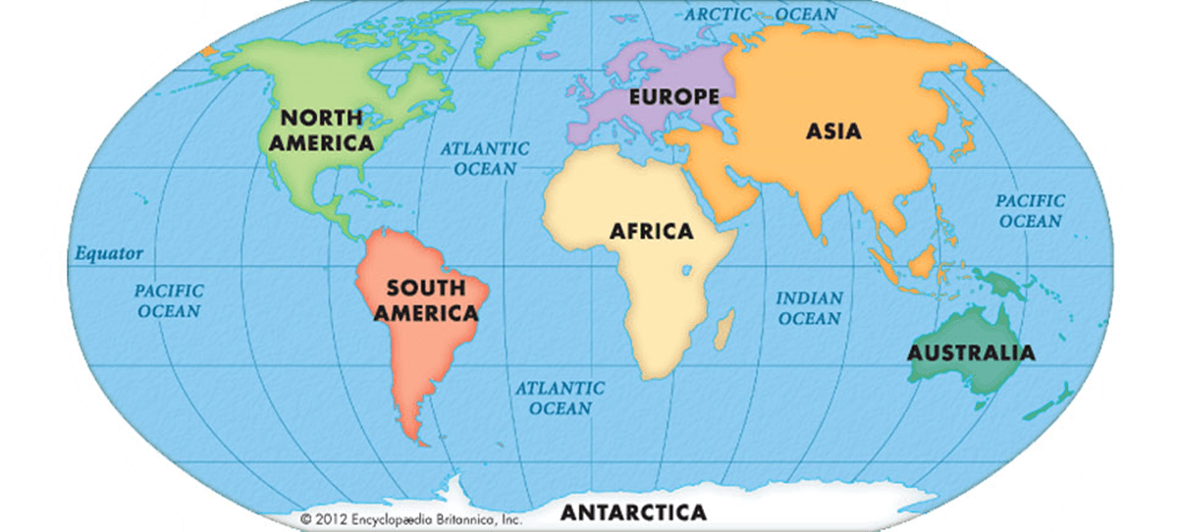
Where is Ghana?

Slide 5
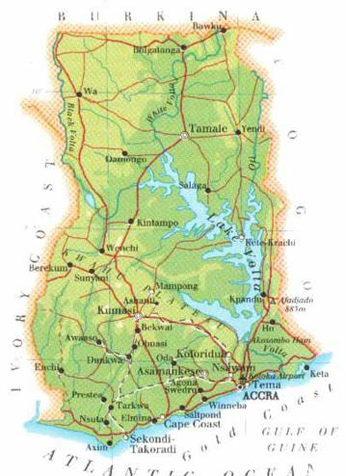

Ghana
Kumasi
Accra

Slide 6
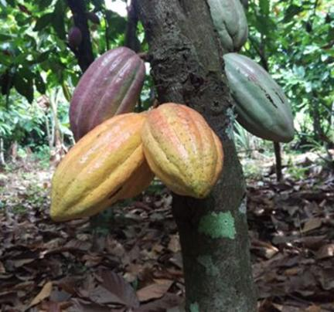
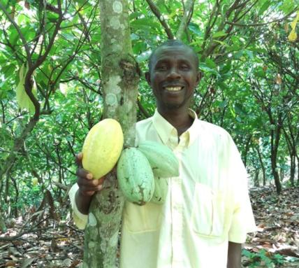
Chocolate is made from cocoa beans which
grow in pods on trees.

Slide 7
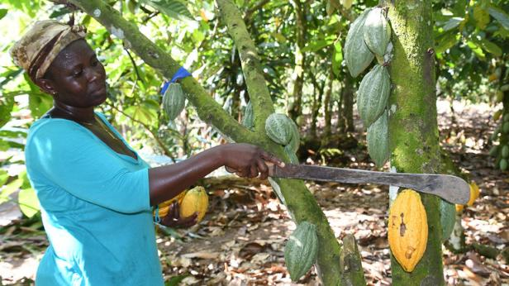
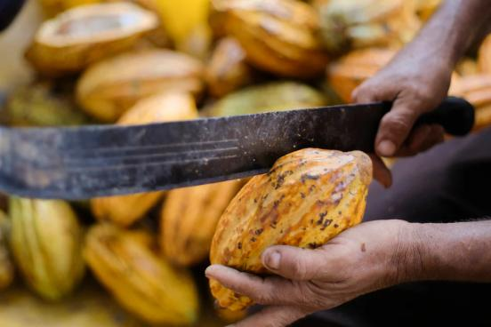
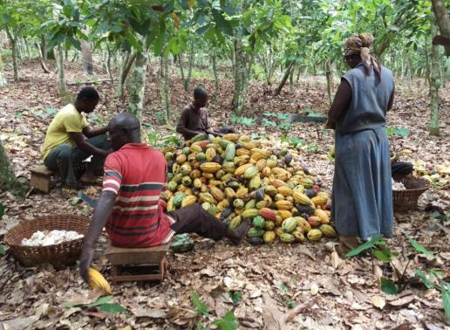
Cocoa pods are cut down
and opened using a
cutlass. The beans are removed and collected.

Slide 8
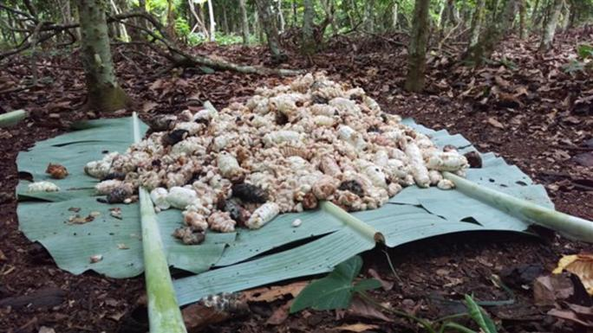
The beans are laid on banana leaves
under the trees

Slide 9
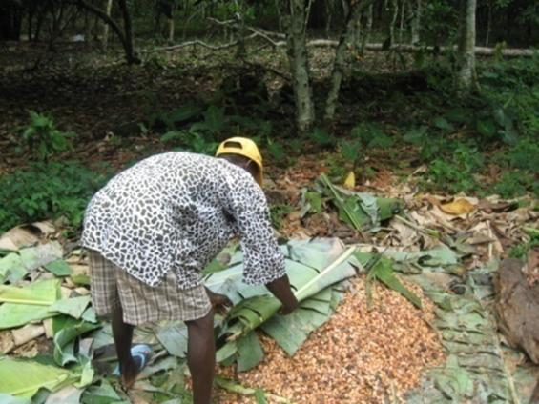
The cocoa beans are then covered with banana leaves and allowed to ferment.

Slide 10
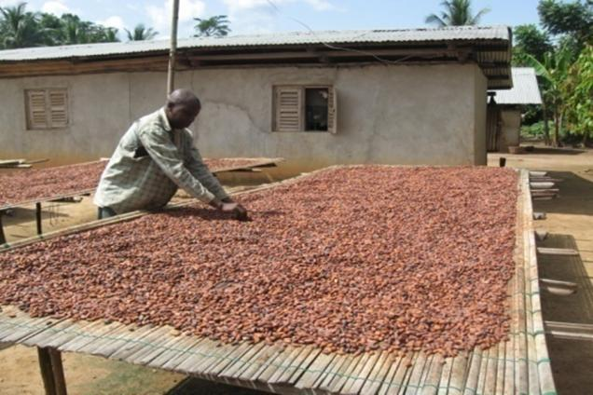
The cocoa beans are laid out on tables and dried
in the sun.

Slide 11
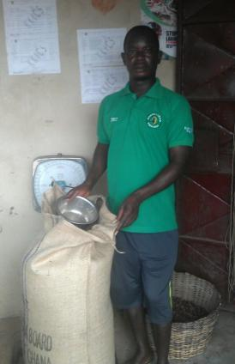
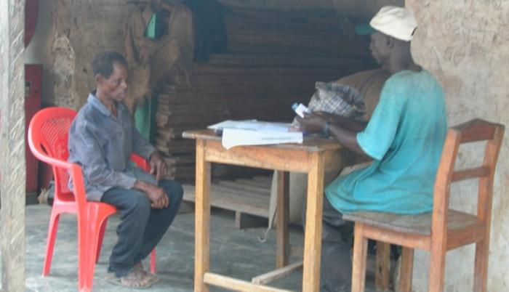
Sacks of beans are weighed, recorded
and then the farmer is paid.

Slide 12
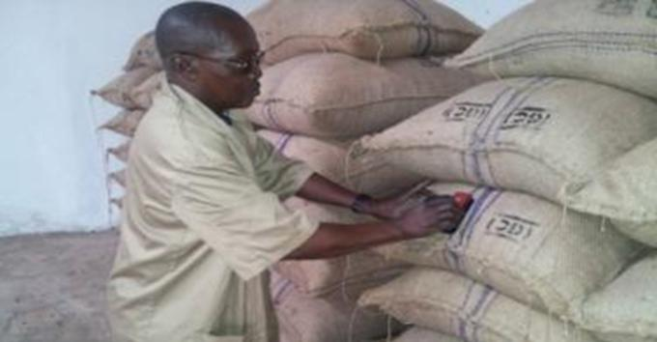
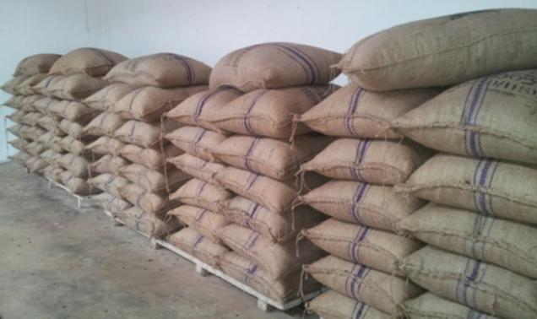
The Quality Controller checks the quality
of the beans. Sacks are then sealed for export.

Slide 13

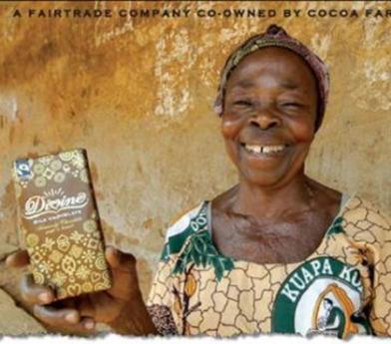
Kuapa Kokoo Farmer’s Union
has co-owned (47%) Divine
Chocolate (1998) which is
manufactured in the UK.
The Farmer’s Union
receive an annual dividend
from Divine which is used for
the community.

Slide 14
Benefits of Fairtrade
Fairer payments to farmers
Guaranteed price – $2,000 per tonne of cocoa beans
Fairtrade Premium an extra payment to the co-op
( $200 per tonne of cocoa beans)
No Child labour
Safe working conditions
Respect for the environment
Notes:
No Child labour

Slide 15
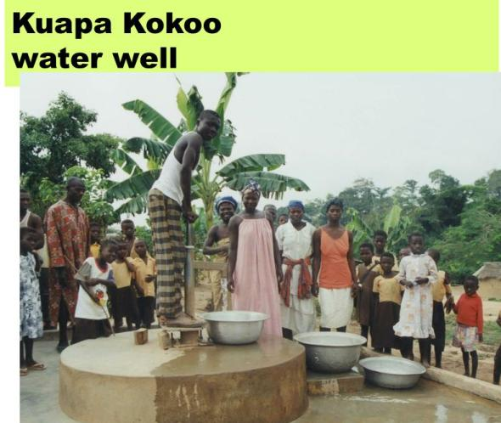
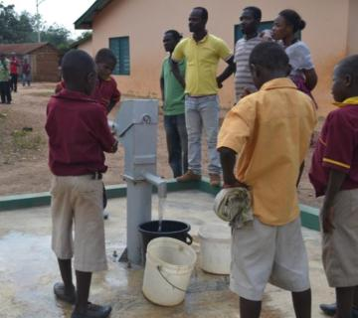
Fairtrade Premium
money in Kumasi
has been spent on:-
Safe drinking water for
communities

Slide 16
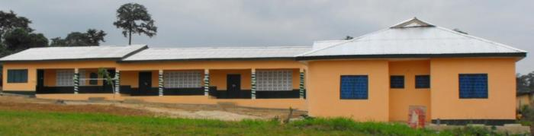
Schools in local communities
Kuapa Kokoo have constructed 9 schools in
local communities and have provided books
and equipment in many other schools.

Slide 17
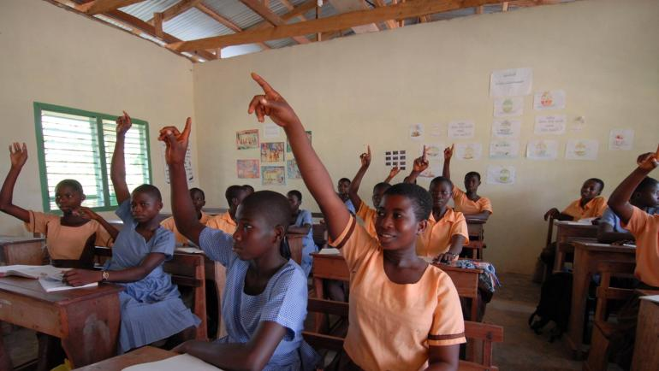
These schools give equal opportunities to both girls and boys

Slide 18
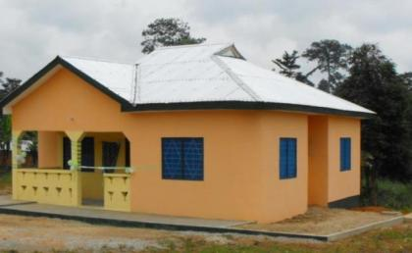
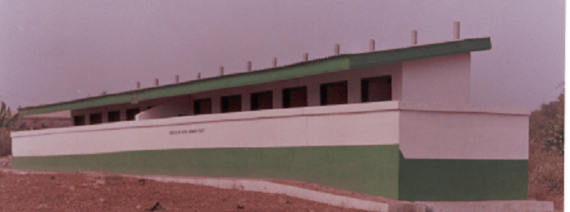
Teachers’ bungalows and toilet blocks
have been constructed with
Fairtrade Premium money

Slide 19
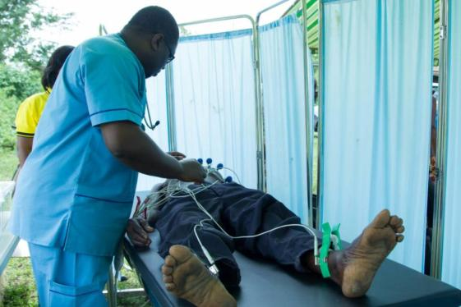
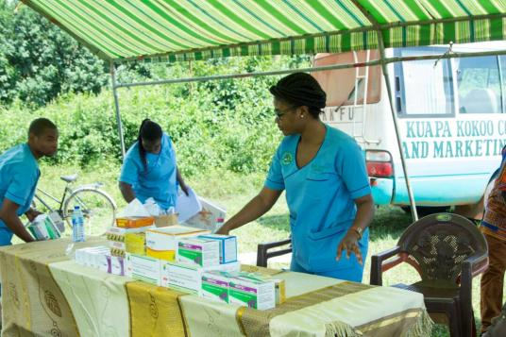
Medical Clinics have been established in local
communities with Fairtrade Premium money

Slide 20
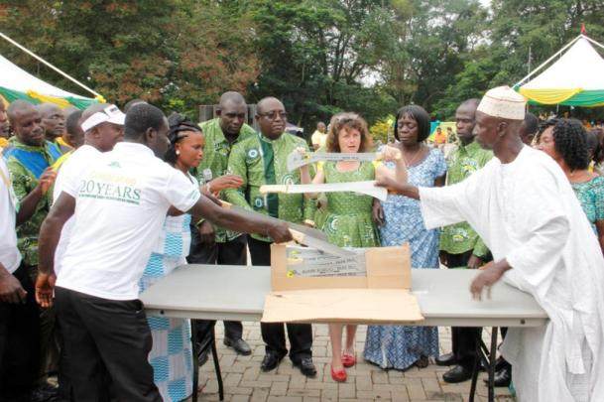
Every year each cocoa farmer receives
a new cutlass

Slide 21

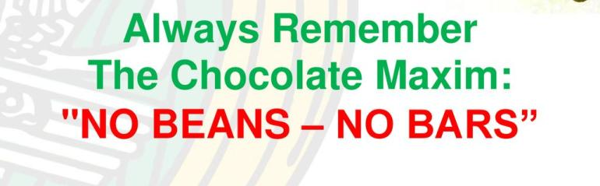
Kuapa Kokoo
logo
Papa Paa means
The Best of the Best

Slide 22
Devon Schools’
Fairtrade Conference 2025
Chocolate Tasting

