Slide 1


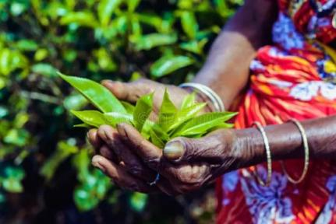

Devon Fairtrade
Schools’ Conference
2025
Tea from
India, Kenya and
Sri Lanka

Slide 2
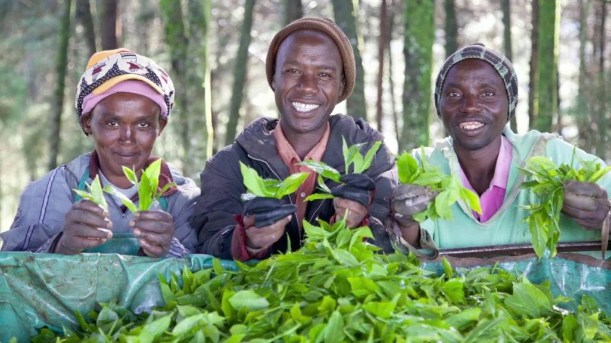

Slide 3
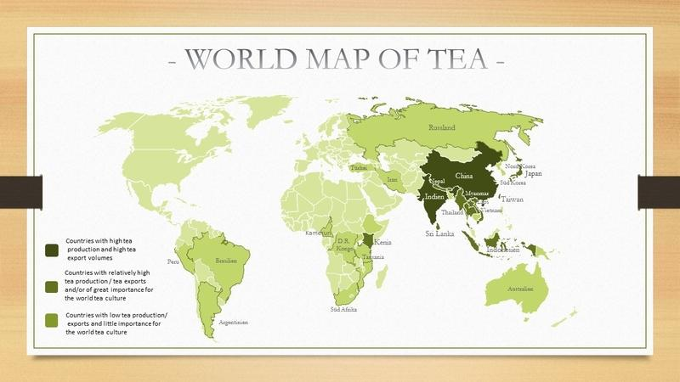


India
Kenya
Sri Lanka

Slide 4
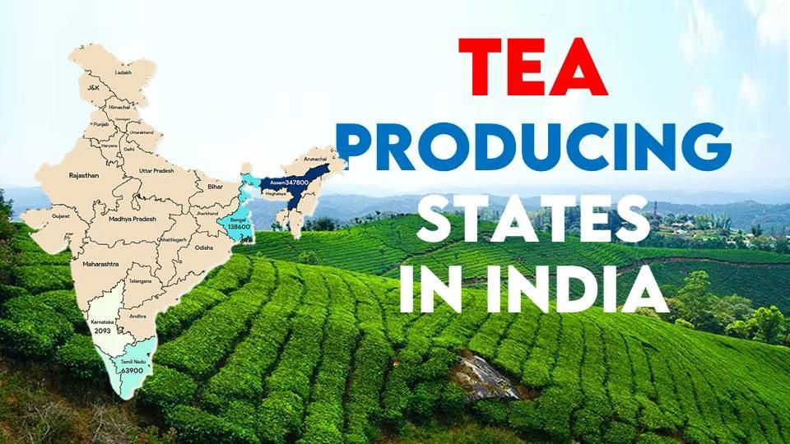
Darjeeling

Slide 5
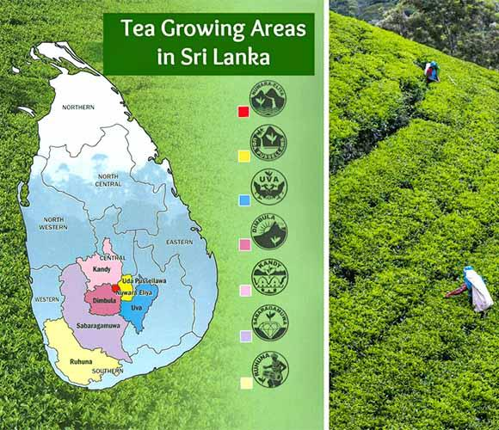

Slide 6
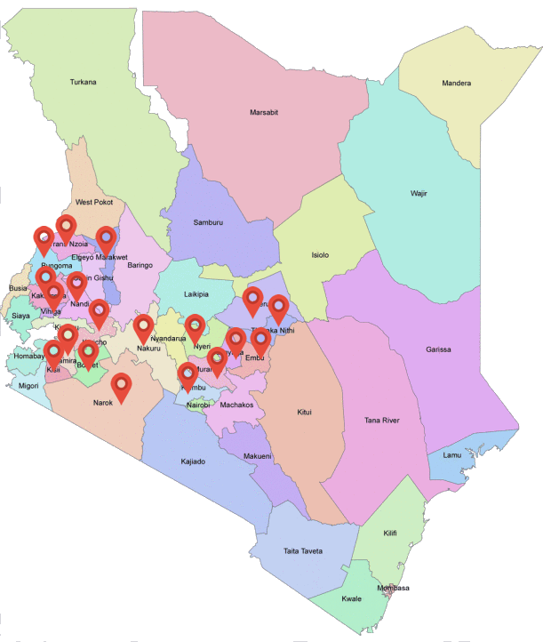
Tea growing areas in Kenya
Sireet Tea
Nandi Hills
In Eldoret

Slide 7
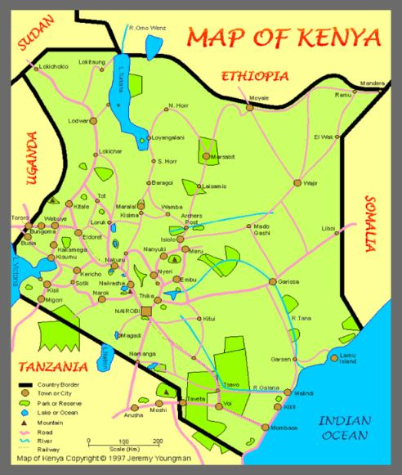
Sireet Tea grown
in Nandi Hills
Eldoret, Kenya

Slide 8
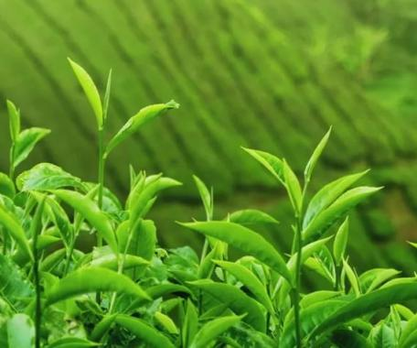
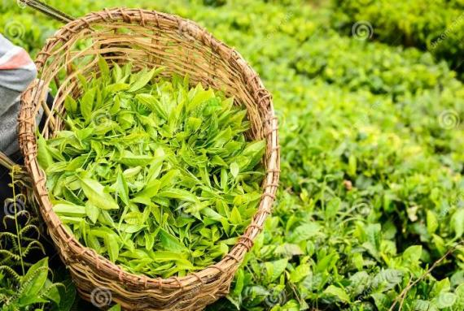
What is tea?
How is tea grown and produced in Kenya?

Slide 9
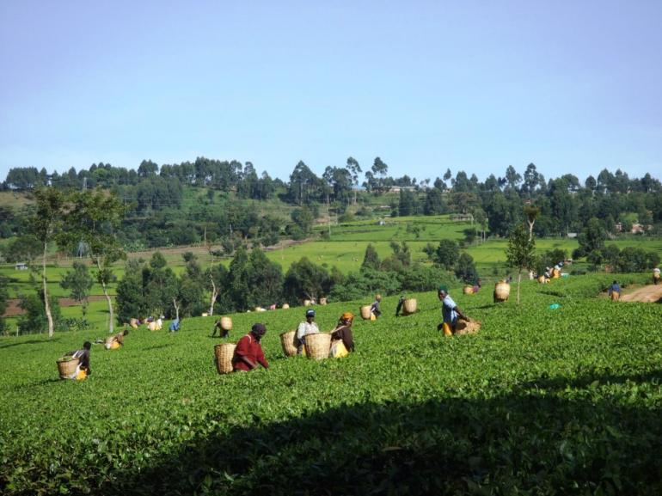
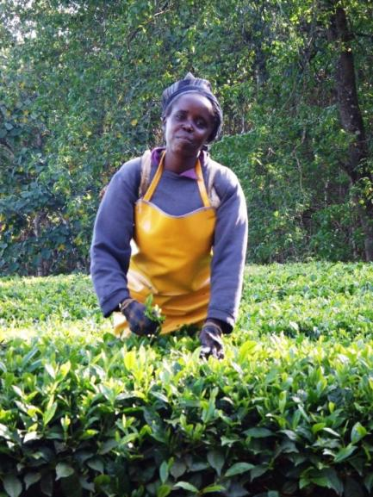
Sireet Tea Pickers
in Nandi Hills

Slide 10
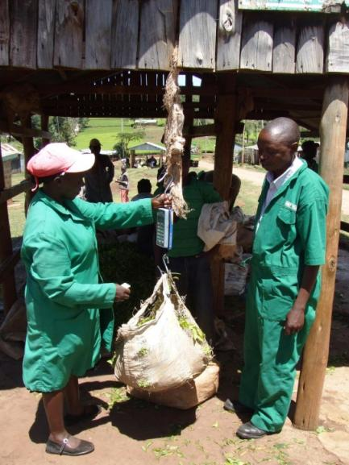
Each picker takes
their full basket
to be weighed
at the weighing station

Slide 11
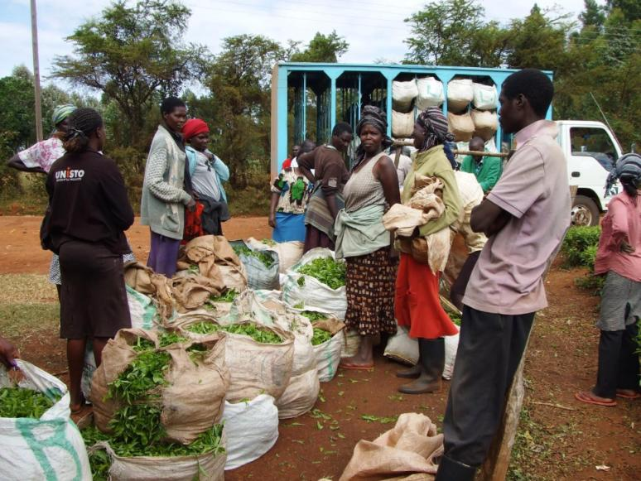
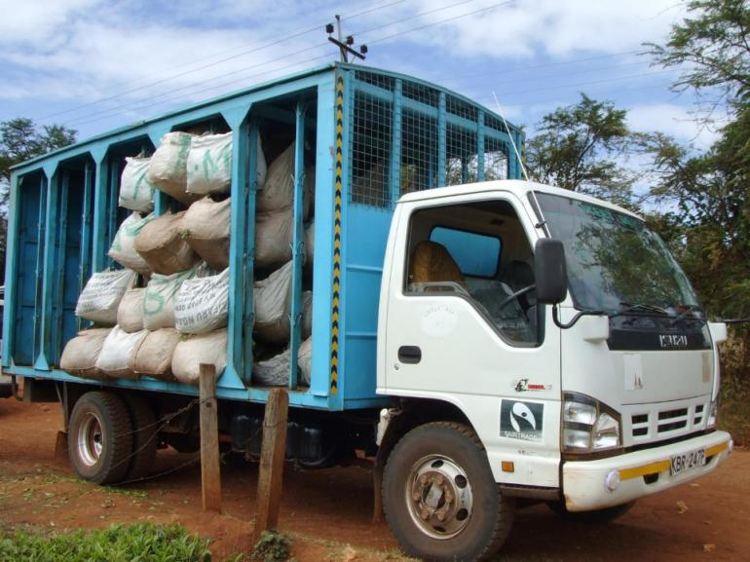


The sacks are
loaded onto a
lorry to be
taken to the
Tea Factory

Slide 12
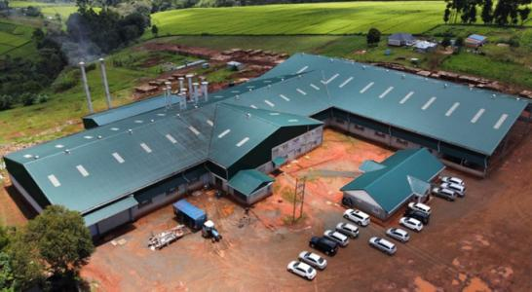


Kamarich
Tea
Factory
As the number of farmers growing tea for the
company increased a new factory was required.
Fairtrade Premium money was used to construct
this factory which was finished in February 2021
and started to process tea in March 2021.

Slide 13
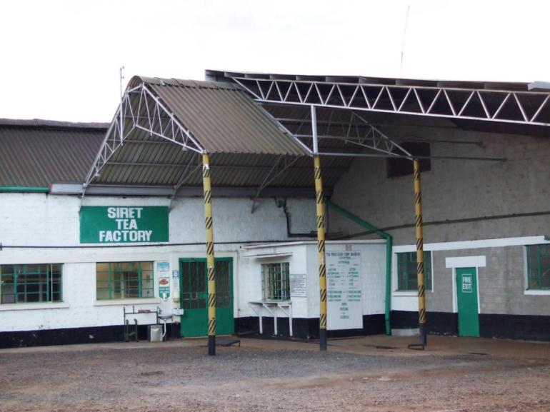

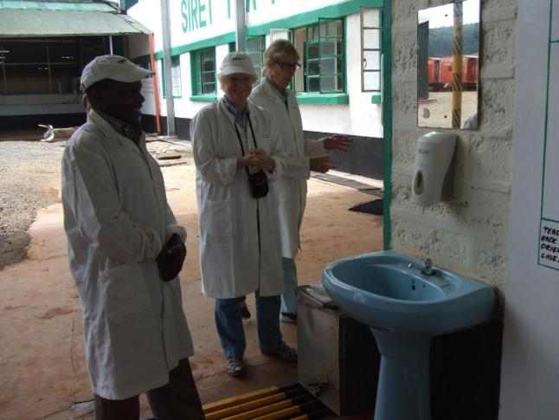

Slide 14
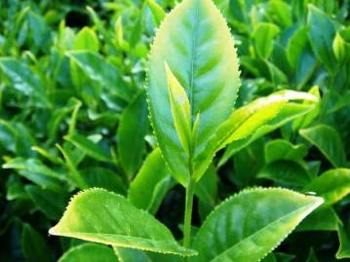
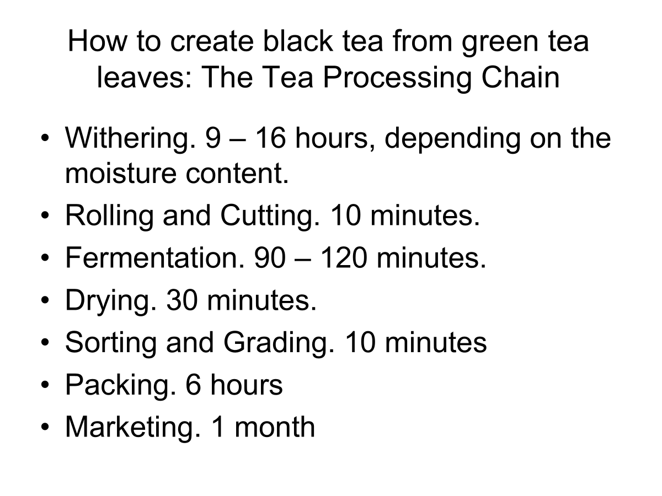
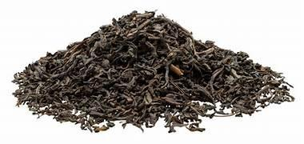


Slide 15
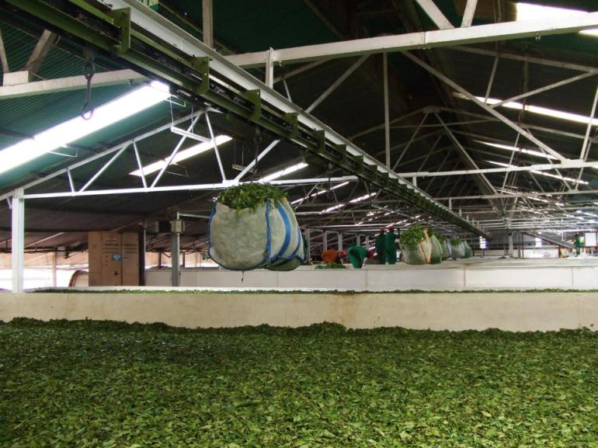


Withering
9-16 hours

Slide 16
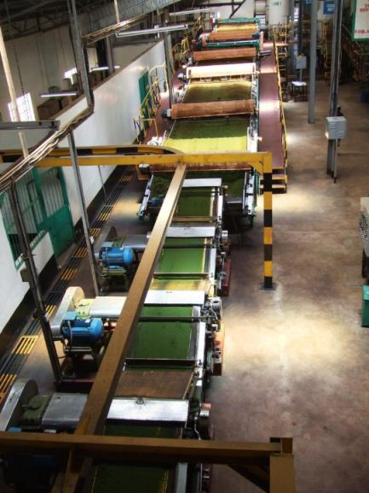

Rolling and Cutting
10 minutes

Slide 17
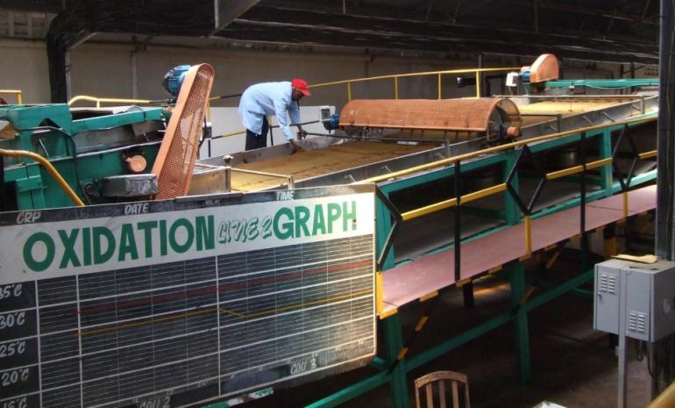


During fermentation
tea leaves are exposed
to oxygen causing
oxidation and a series
of chemical changes
that transforms the
colour from
green to brown.
Fermentation 90-100 minutes

Slide 18
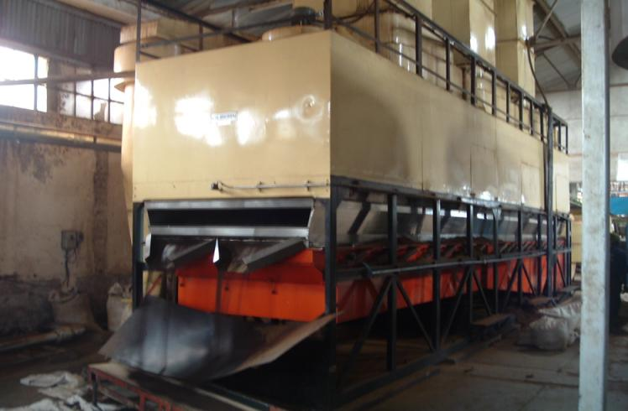


Drying- 30 minutes

Slide 19
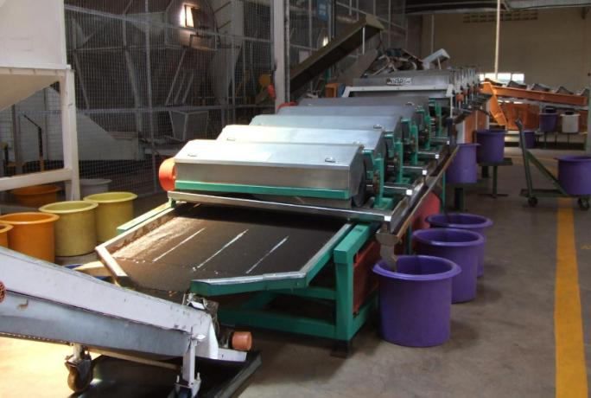

Sorting and grading -10 minutes

Slide 20
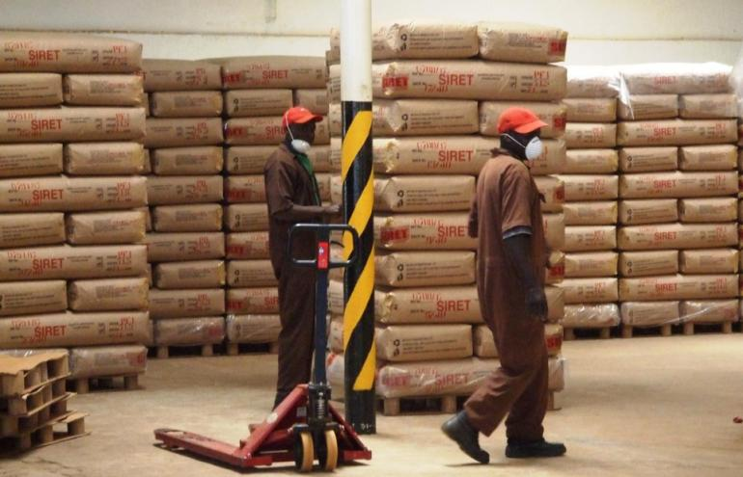

Packing – 6 hours

Slide 22
Tea Quiz
True or False –
Apart from water TEA is the world’s most popular drink?

Slide 23
Tea Quiz
2. Which country drinks the most tea in the world?
United Kingdom
b) China
c) India
d) Turkey

Slide 24
Tea Quiz
3. What percentage of tea is certified in the UK as Fairtrade?
10%
b) 50%
c) 75%

Slide 25
Tea Quiz
4. Which country grows the most Fairtrade tea?
China
India
c) Kenya

Slide 26
Tea Quiz
5. How many cups of tea are drunk in Britain per day? Our population is 69.2 million
50 million b) 120 million
c) 160 million

Slide 27
Tea Quiz
6. Where does tea grow in Kenya?

Slide 28
Tea Quiz
7. When the tea picker has a full basket of tea leaves what happens next?

Slide 29
Tea Quiz
8. Put the six process at the tea factory in order
Drying,
Packing,
Withering,
Rolling and Cutting,
Sorting and Grading, Fermentation

Slide 30
Tea Quiz
9. At which stage did the leaves change colour from green to brown?

Slide 31
Tea Quiz
10. What is the Fairtrade Co-operative tea company’s name in Kenya?

Slide 32
Tea Quiz - answers
Apart from water TEA is the world’s most popular drink?
True
2. Which country drinks the most tea in the world?
d) Turkey
3. What percentage of tea is certified in the UK as Fairtrade?
10%
4. Which country grows the most Fairtrade tea?
c) Kenya

Slide 33
5. How many cups of tea are drunk in Britain per day? Our population is 69.2 million
c) 160 million
6. Where does tea grow in Kenya?
Nandi Hills, Eldoret
7. When the tea picker has a full basket of tea leaves what happens next?
The picked tea is weighed

Slide 34
8. Put the six process at the tea factory in order
Withering
Rolling and Cutting
Fermentation
Drying
Sorting and Grading
Packing
9. Which stage did the leaves change colour from green to brown?
Fermentation or Oxidation
10. What is the tea co-operative company’s name in Kenya?
Sireet

Slide 35
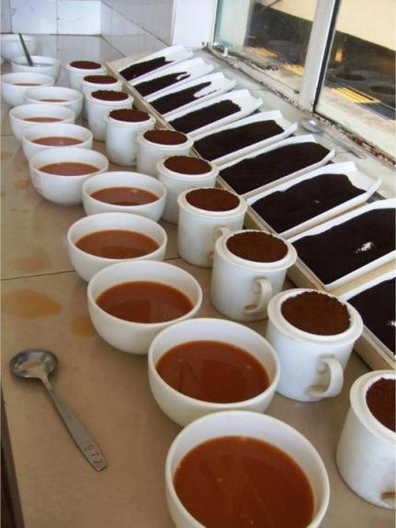
Tea Tasting
Darjeeling
Ceylon
Kenyan
Shape/smell of leaves
Colour of liquor
Aroma or smell
Taste/flavour of tea
Finish/feeling in
mouth

Slide 36


Colour of Liquor
Aroma
Shape of leaves
Taste
Finish or feeling in mouth
C
E
Y
L
O
N

Slide 37
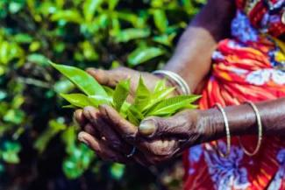
Devon Fairtrade
Schools’ Conference
2025
BREAK

Slide 38
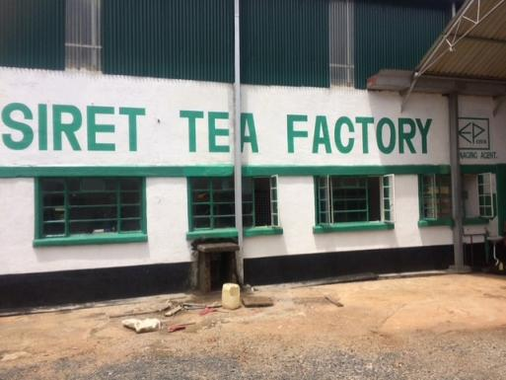
Sireet Tea Factory
Environmental Issues

Slide 39
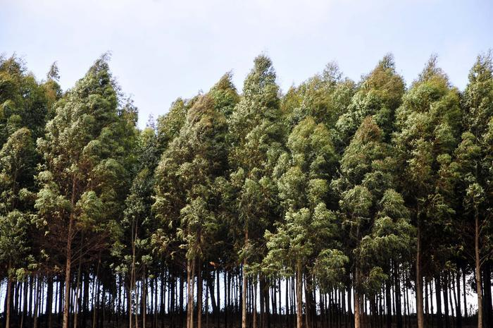
Eucalyptus Trees growing on the Tea Estate

Slide 40
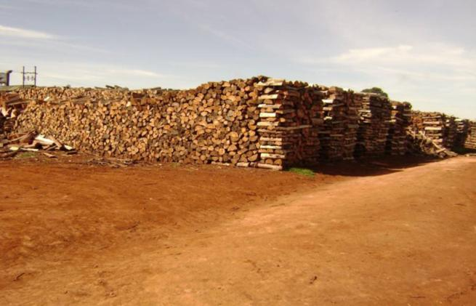
The trees are cut, left to season
and dry out in this wood lot
close to the factory.

Slide 41
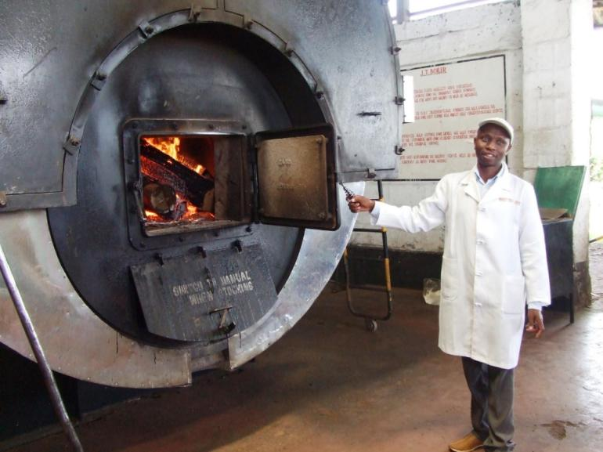
Heat from the
wood furnace is
used for the
Withering,
Fermentation and
Drying processes.

Slide 42
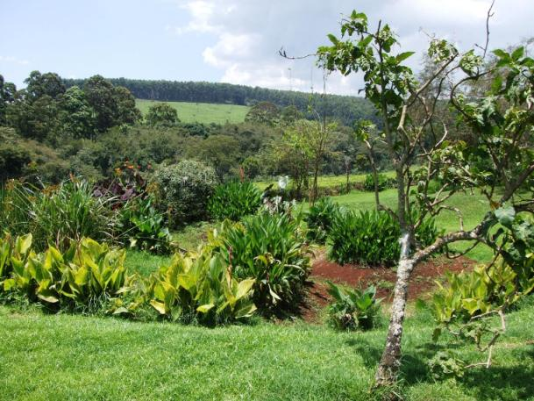
All wastewater
from the Sireet
Tea Factory is piped through reed beds in this beautiful garden
near the factory
to be cleaned and
then re-used.
Here are the eucalyptus trees
which belong to the factory

Slide 43

Instructions on how to make a
pot of tea or a cup of tea
1.
2.
3.
4.
5.
6.

Slide 44

Instructions on how to make a pot of tea
Fill a kettle with fresh water and bring to boil.
Warm the teapot with hot water.
Place two teabags in the pot.
Pour the boiling water into the pot.
Stir the tea and let it stand for 3-5 minutes to brew.
Pour the tea into a cup with some milk if required.

Slide 45
Fairtrade and its Benefits
In 2006 Sireet Co-operative OEP became Fairtrade accredited and had
One tea factory
One tea plantation
6,000 members growing tea on their land
90,000 – 120,000 kg green leaf tea processed per day
Now in 2025 Fairtrade Co-operative Sireet OEP has
Two tea factories
Two tea estates
10,000 members growing tea on their land
180,000-240,000 kg green leaf tea processed per day

Slide 46
Benefits of a Fairtrade Co-operative
Guaranteed minimum price for the tea
Fairer Payments to farmers (10,000)
No child labour
Safe working conditions
Respect for the environment
Fairtrade Premium
Training

Slide 47
What is the Fairtrade Premium?
Fairtrade Premium is an amount
of money paid to the co-operative from
the buyers of the tea.
An additional 36p is paid in Fairtrade
Premium for every kilogramme of
black tea sold

Slide 48
Since 2006 Sireet Co-operative has invested their Fairtrade Premium in:
£300,000 spent on bursaries
for over 5,000 Secondary School and College students
£2,500 revolving loan scheme for staff

Slide 49
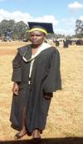
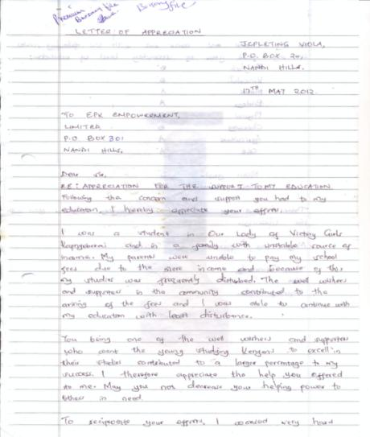
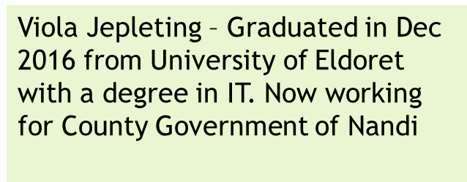

Slide 50
14 school projects including
science labs,
classrooms
modern kitchens

Slide 51
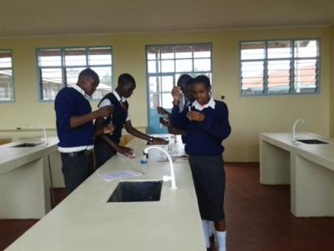
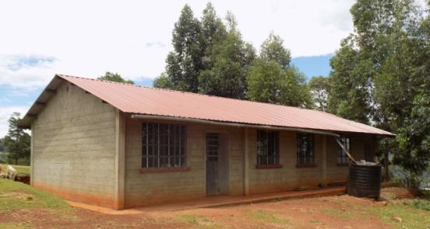
Cheptabach Secondary
School Laboratory

Slide 52
8 water projects including
Water tanks
Boreholes or well

Slide 53
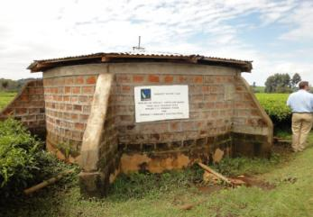
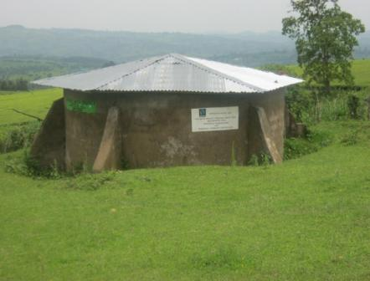
These water tanks are
gravity fed so very sustainable. They each serve
around 1500-3000 people in the community and
are used for drinking, washing and agriculture.

Slide 54
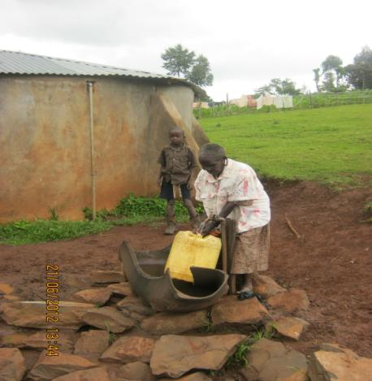
Kaputi Water Project
Mrs Kobot Arusei was
over 90 years old and had to
walk over 2 kms up and
down a steep hill to fetch
water. Now she only has
to walk 50 meters to
fetch her water.

Slide 55
9 Medical Projects including
Dispensaries
Laboratories
Outpatient clinics
Maternity wings
Medical staff houses

Slide 56
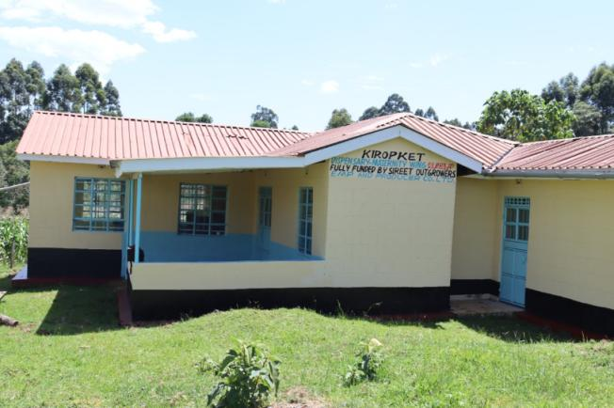
Kiropket Maternity Wing
Over 100 babies
have been born
in this
Maternity Wing.
Classes
for mothers and
vaccination
clinics are held
here.

Slide 57


Slide 58


Fairtrade School Action
Ask your teachers and your School Council to become a Fairtrade School.
Go home and tell someone about Fairtrade.
Encourage your family to buy a Fairtrade product regularly.
Ask if Fairtrade products are used in the staffroom at your school.

Slide 59
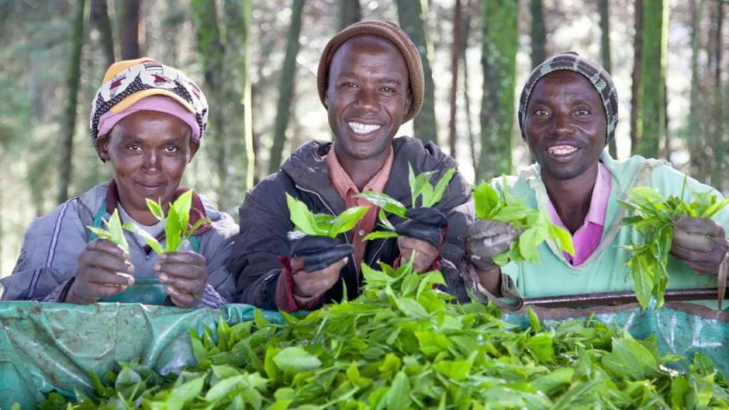

Slide 60
Thank you for attending
Devon Fairtrade
Schools’ Conference
2025

